Slide 1





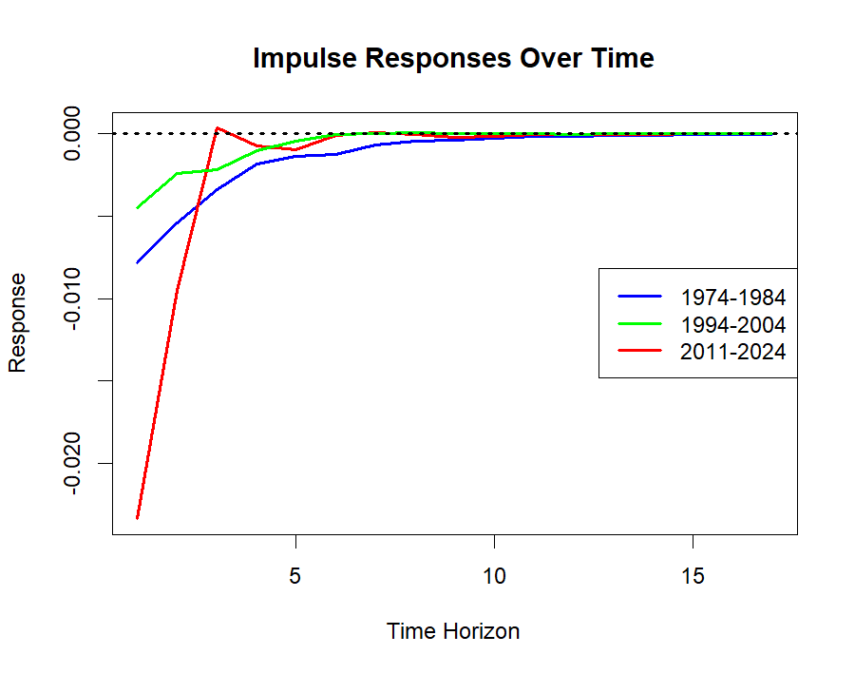
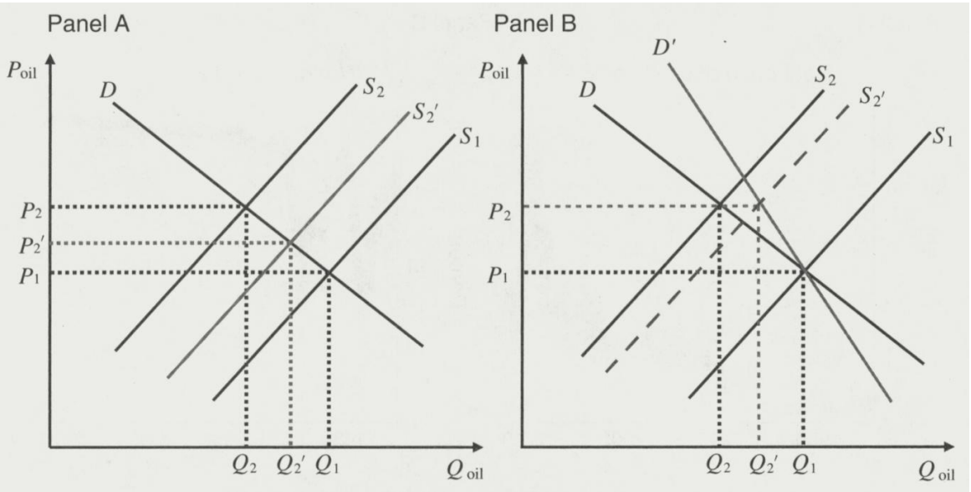

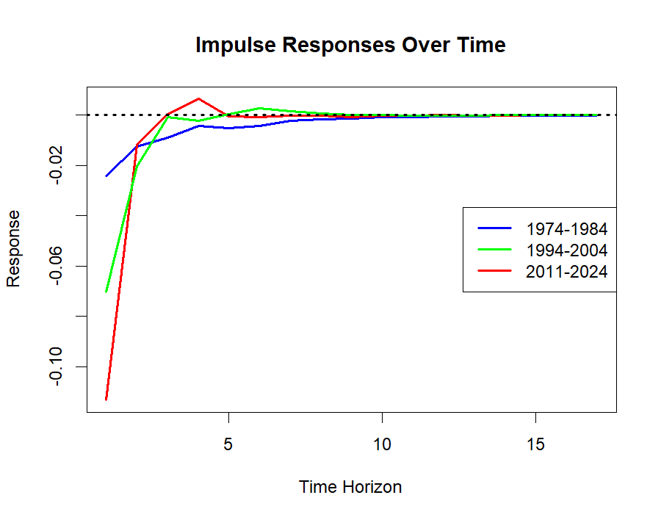
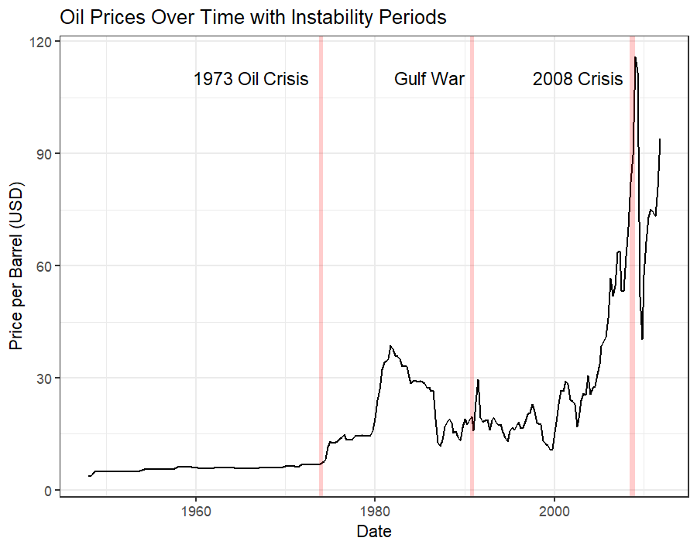


Replication and Extension of “Time-Varying Effects of Oil Supply Shocks on the US Economy”, by Baumeister and Peersman.
Kolby Porter – University of Texas at San Antonio
Abstract
Methodology
Robustness
This study extends the research done by Christiane Baumeister and Gert Peersman regarding their analysis of oil supply shocks and their relevance to the price elastic of demand within the US economy. By examining the evolution of oil price elasticity and its macroeconomic implications using sign restricted vector autoregression models, Baumeister and Peersman were able to find a significant decline in the short-run price elasticity of oil demand beginning in the mid-1980s.
This decline implies that oil production shortfalls exert disproportionately large effects on prices and macroeconomic factors, while price changes induce more muted effects on production and other economic outputs, highlighting greater resilience in production to price fluctuations compared to the responsiveness of price to production changes.
Additionally, the findings reveal that the relative importance of oil supply shocks in driving price variability has diminished over time, with demand shocks now playing a more prominent role. Consequently, the macroeconomic effects of oil supply disruptions in recent periods have been relatively modest, reflecting increased resilience in the broader economy. The same conclusion hold for similar analysis performed with data from recent years (2011-2024).
The methods used in this analysis include sign restrictions within time-varying parameter regressions. The author does this to measure the impact of shocks on the various inputs and how they evolve over time. The recursive structure of a traditional VAR is maintained by ordering the variables as, they are listed below. The specification below is maintained for the extended research portion.
where $y_{t}$ ≡ [Δq_{t}^{oil} , Δp_{t}^{oil}, Δgdp_{t} , Δcpi_{t}]
The model specified above uses the impulse response functions of price and production to analyze the dynamics of oil supply and demand shocks. The results highlight an increasing sensitivity of oil prices to production shortfalls over time, which signals a decline in the price elasticity of demand for oil.
The authors use the graphs below to illustrate the observed shift in price elasticity of demand over time. Panel A represents the short-run effects of a supply shock, where a leftward shift in the supply curve leads to a moderate increase in price. Panel B reflects the long-run effects found in the analysis, where a similar supply shock results in a significantly larger price increase due to a decline in the price elasticity of demand. The disparity in price levels between the two panels highlights the growing sensitivity of prices to supply disruptions over time.
In evaluating price elasticity of demand for crude oil, the market for synthetic plastics, specifically styrene-butadiene rubber (SBR) and ethylene propylene, in theory should serve as a contemporary for oil. SBR and ethylene/propylene products are derived from specific byproducts of the petroleum refining process, making their production somewhat adjacent to that of refined petroleum.
Using a sign-restricted VAR model similar to the one applied to evaluate crude oil prices, the response of synthetic rubber PPI is shown to the right. This analysis indicates that the price elasticity of demand for plastics fluctuates over time, we do not observe the same steady decline in elasticity—stemming in the 1970s—that we identified with crude oil.
$$y_{t}=c_{t}+B_{1,t}y_{t−1}+…+B_{p,t}y_{t−p}+u_{t}≡X_{t}^{′}θ_{t}+u_{+}$$
While shocks to oil supply negatively impact synthetic rubbers, the same gradual decline in price elasticity of demand is not observed. This suggests that the source of the decline in price elasticity is likely transportation-driven. As a hypothesis, airline travel, despite the limitations in pre 2000s time-series data, could correlate closely with the decrease in crude oil's price elasticity over time.
Introduction
Sign restrictions are imposed on the structural VAR model to identify economic shocks by specifying how key variables should respond to a given shock. For example, a shock to oil production (e.g., a shortfall) is assumed to have a negative effect on price, reflecting the fundamental economic relationship that a decrease in supply leads to higher prices.
This methodology allows for shocks to be interpreted as follows:
A supply shock (e.g., production shortfall) results in a negative response in price and other macroeconomic variables like GDP and CPI, while production itself declines.
A price shock (e.g., demand-driven price increase) has a positive effect on price but may result in negative effects on GDP and CPI.
The recursive structure of the sign restriction matrix ensures that each shock type has distinct, interpretable effects on the variables, consistent with economic theory.
Results
Add your information, graphs and images to this section.
Conclusion
The relationship between oil prices and the broader economy has evolved considerably over time, reflecting structural and behavioral changes in the global oil market. Recent evidence suggests that oil price shocks, particularly those originating from supply disruptions, have had relatively muted macroeconomic effects in recent decades. This can be attributed to the shifting composition of price shocks, which now stem more from demand-driven fluctuations than supply constraints.
To extended the results found, a series of sign restricted VAR models were imposed on different decades to illustrate the persisting shift in price elasticity of demand. The general trends and magnitudes of the responses offer insights into changes in price elasticity of demand and the broader dynamics of the oil market over time.
In summary, long-term oil price volatility is now driven largely by oil demand shocks rather than supply shocks. This underscores how market integration and technological advancements have enhanced resilience to supply-side disruptions while the U.S. market remains sensitive to unforeseen changes in demand. Specifically:
Decreasing price elasticity has amplified the immediate price response to supply shocks.
Diminished long-term effects on prices and macroeconomic variables reflect faster market adjustments.
Synthetic plastics do not share the same decline in price elasticity of demand despite being derived from crude oil
While the U.S. economy has incorporated contemporary alternatives to oil in certain areas, oil still lacks large-scale substitutability, maintaining its critical role in economic activity.
Key factors underlying these changes include the declining oil intensity of U.S. economic activity and the transition of oil trading to a market-based system. These shifts have contributed to the growing consensus that the price elasticity of oil demand has decreased over time, amplifying the price effects of production shortfalls while dampening the economic impact of price fluctuations.
The sign restriction matrix is grounded in economic theory. Oil production, as a supply-side factor, is assumed to be contemporaneously independent due to the quarterly structure of the data. GDP and CPI are influenced simultaneously by changes in oil prices and production.
Within this framework, price elasticity of demand is inferred by examining the response of the real price of oil to an unexpected production shortfall (a supply shock). A larger price response to such a shock indicates a lower price elasticity of demand, as it reflects a steeper demand curve.
The responses show a clear trend of increasing sensitivity of prices to production shocks over time, consistent with the findings of Baumeister and Peersman. The faster decay of responses in recent periods highlights the evolution of global oil markets, which have become more resilient to supply-side disruptions, likely due to increased market integration, energy diversification, and technological advancements.
Another important outcome of this analysis is the observed resilience of oil prices to supply shocks over the longer term. The IRFs reveal that while the initial price response to supply disruptions has grown larger—reflecting a decline in price elasticity of demand the effects of these shocks on prices diminish more rapidly in recent decades. This suggests that modern oil markets are increasingly capable of absorbing supply-side disruptions and stabilizing prices over time. The ideas are consistent when extending the analysis.
Acknowledgements
Data for contemporary analysis:
U.S. Bureau of Labor Statistics. Consumer Price Index (1982-1984=100). Retrieved from https://www.bls.gov/cpi/.
Federal Reserve Bank of St. Louis. Real Gross Domestic Product (2012 Dollars). FRED, Federal Reserve Economic Data. Retrieved from https://fred.stlouisfed.org.
U.S. Energy Information Administration. Monthly Energy Review: Total World Crude Oil Production (Thousand Barrels per Day). Retrieved from https://www.eia.gov/mer.
U.S. Energy Information Administration. U.S. Petroleum and Other Liquids Data, Refiner Acquisition Cost of Crude Oil (Dollars per Barrel) https://www.eia.gov/dnav/pet/pet_pri_rac2_dcu_nus_m.htm.
Subject of focus and data for replication:
Time-Varying Effects of Oil Supply Shocks on the US Economy Author(s): Christiane Baumeister and Gert Peersman Source: American Economic Journal: Macroeconomics , October 2013, Vol. 5, No. 4 (October 2013), pp. 1-28 Published by: American Economic Association https://www.aeaweb.org/articles?id=10.1257/mac.5.4.1
Other sources used for reference material:
Barsky, Robert, B., and Lutz Kilian. 2004. "Oil and the Macroeconomy Since the 1970s." Journal of Economic Perspectives, 18 (4): 115–134. https://www.aeaweb.org/articles?id=10.1257/0895330042632708
Kilian, Lutz. 2009. "Not All Oil Price Shocks Are Alike: Disentangling Demand and Supply Shocks in the Crude Oil Market." American Economic Review, 99 (3): 1053–69.DOI: 10.1257/aer.99.3.1053 https://www.aeaweb.org/articles?id=10.1257/aer.99.3.1053
The analysis done by Baumeister and Peersman examines the effects of oil price variability on global production as well as macroeconomic factors such as gross domestic product and consumer price index. This analysis allowed the author to capture time varying responses of GDP and consumer prices to oil supply shocks as well as changes in the short-run price elasticity of demand.

